Slide 1
Test Automation Pipeline Enabling Critical Feedback For Your Quality Cycle
Maciek Konkolowicz
Software Quality Architect
Title Source Technology
Notes:
General Notes:
*Take screenshots instead of videos (LARGE)
*What value is there in logging in???
*NO LASER POINTING!!!!!!
*Take screenshots and put boxes to draw attention
*Full screen lower resolution
*Ignore template for screenshots
*Use the space that you need: IMAGE: Edge to edge
*Ditch videos and replace with screenshots
*Do not do videos inside the template
*Modify template to take up less room
-Paid vs. Free flowchart bogged down
-Customize to show other tools can be plugged in
-incorporate a few more points of view
-Use the logo and move it to bottom left , to free up some real estate
-Don’t use graphics for background , use powerpoint objects
-Bring back the story, lost in the middle, try to tie the threads

Slide 2


Slide 3
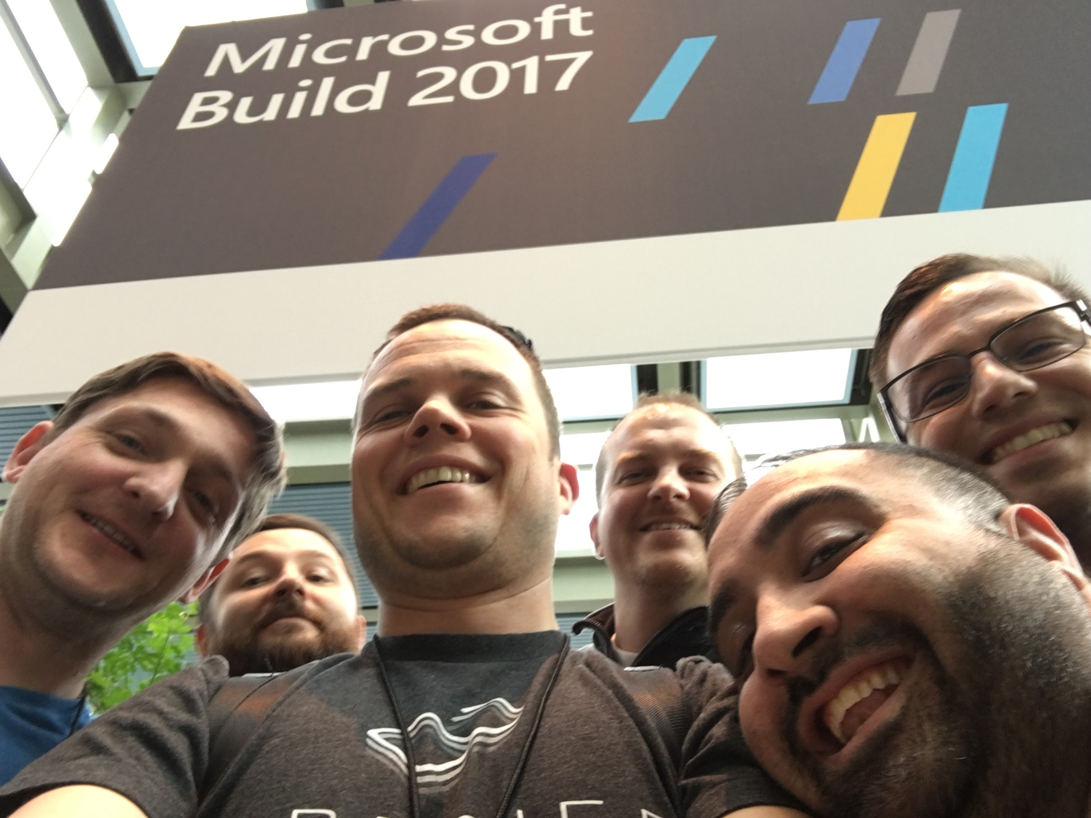
Notes:
I’m basically a curious tech dude, who came into the field of quality about 10 years ago. I’m a firm believer in using automated testing as a primary method of quality assurance. I love learning about new technologies and methods of assuring quality. I love helping people through knowledge sharing, coaching and encouraging testing as a team sport. In my spare time I love to race sailboats, ski and spend time with my friends and family.
NOTES: Break into 3 slides
-Enough title promotion in the title, can keep podcast and twitter

Slide 4
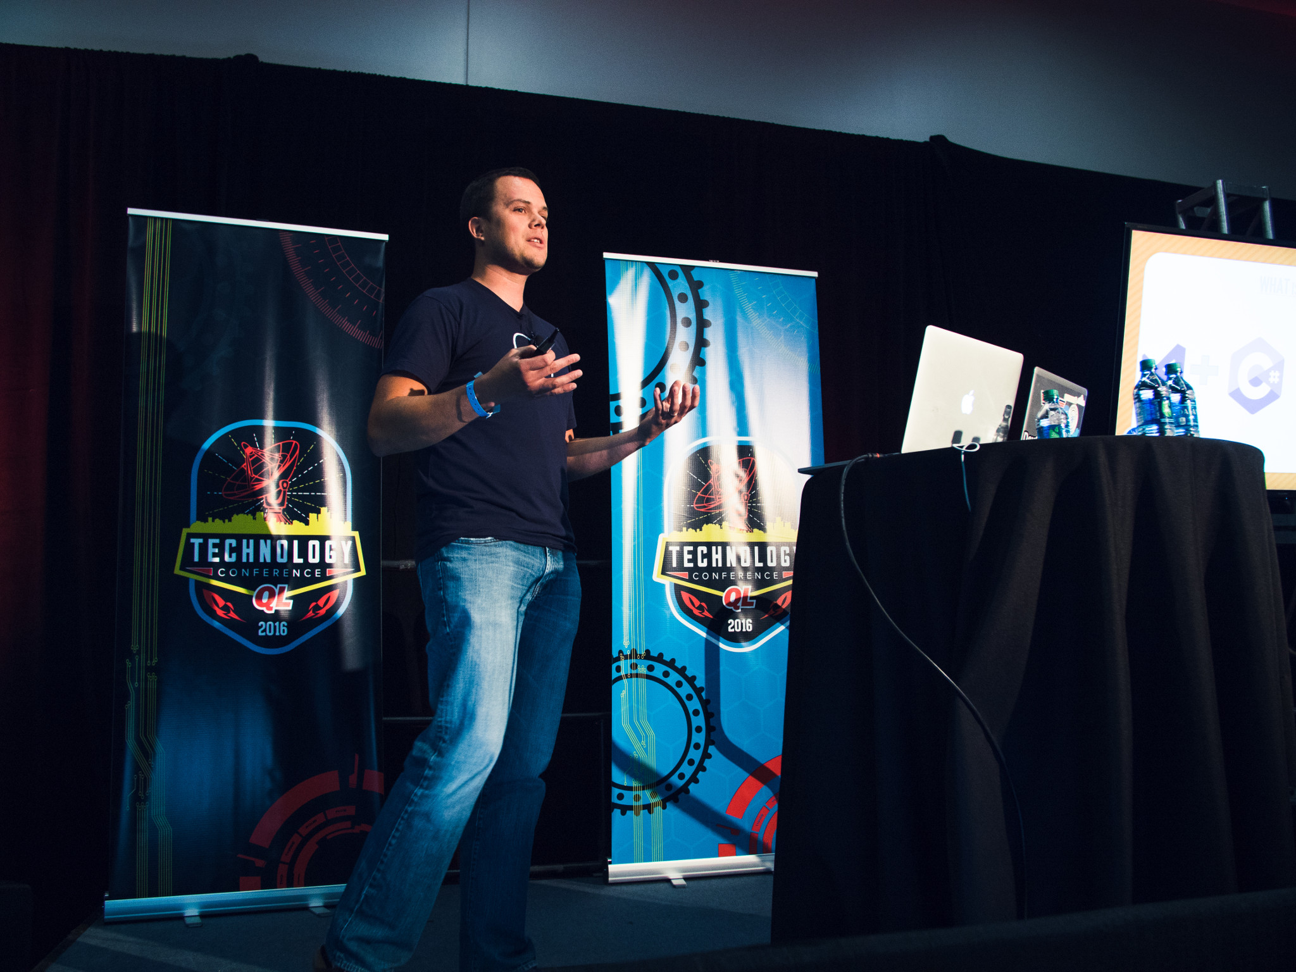

Slide 5


Shameless Promotion #1
@mkonkolowicz
http://macie-j.me

Slide 6

Shameless Promotion #2

Slide 7


Shameless Promotion #2
@TitleSourceTech
Title Source Tech
http://www.titlesourcecareers.com

Slide 8
Test Automation
“Software to automate checking that humans shouldn’t need to do”
-Maciek, Just Now
Notes:
Test automation refers to the automated test that are executed during an application’s development for the purpose of establishing quality.

Slide 9
Who Has A Test Automation Process?
Notes:
Based on this definition, how many of you have some sort of test automation process?

Slide 10
Quiz Time!
Notes:
We’re going to take a quiz together. Let’s determine how mature of a process you have, and how we can make it better.

Slide 11

Question 1: Can You Run One Test?
Notes:
1. Can you run one automated test?

Slide 12
Question 2: Can You Run Many Tests?
Notes:
Can run multiple tests at once?

Slide 13



Question 3: Can You Run Tests In Many Environments?
Notes:
What about Multiple Tests in multiple environments?

Slide 14


Question 4: Can You Scale Your Tests?
Notes:
4. Can you run many automated tests, in pre determined environments all at once?

Slide 15

Question 5: Can Anyone Run And Examine Your Tests?
Notes:
5. Can anyone on your team, run and examine your results? Can your product owner do this? Is your QA the only one who can do this?

Slide 16

Notes:
How many people were able to answer yes to all of the questions? Probably not many of you. But let’s not worry about results. Let’s look forward, to the future, let’s think of how we can improve.

Slide 17

Notes:
Seems like we have some degree of automation in the crowd, but if we don’t have an effective way to organize, scale, and share results of our test automation, we are merely at hamster level. We have a proof of concept, but we are not taking full advantage of the power of test automation. How do we unleash it?????

Slide 18
Test Automation Pipeline
“A scalable process for delivery of automated checking that humans shouldn’t need to do!”
-Maciek, Just Now ++

Slide 19
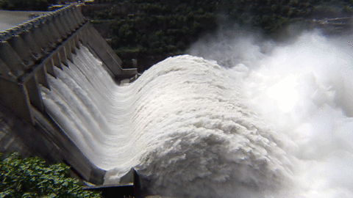
Notes:
Seems like we have some degree of this. But we have room for improvement! But if we don’t have an effective way to organize, scale, and share results of our test automation, what good is it anyway?

Slide 20
Test Automation Pipeline
GOAL: Scale, Share, Broaden, Your Test Automation!

Slide 21
Test Automation Pipeline Core Concepts

Slide 22
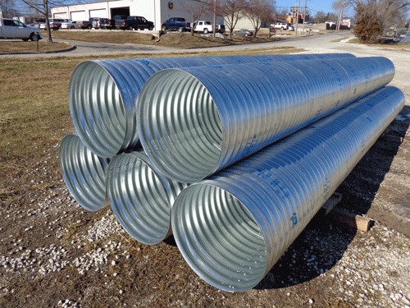
Generic: Testing For Any Product
Notes:
The process is generic: it can be applied to the testing of any product.

Slide 23
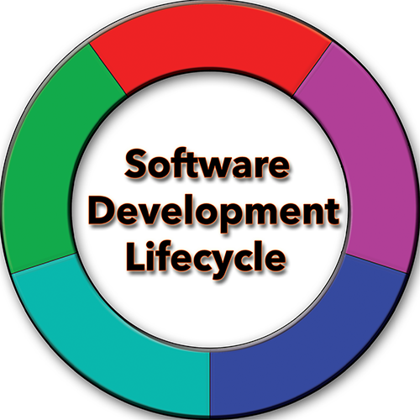
Adopted Early: Minimize Ambiguity
Notes:
The process is adopted early in the SDLC: This minimizes ambiguity when execution failures arise. You will know whether the environment is to blame or not to blame.

Slide 24
Test Automation Pipeline Components

Slide 25

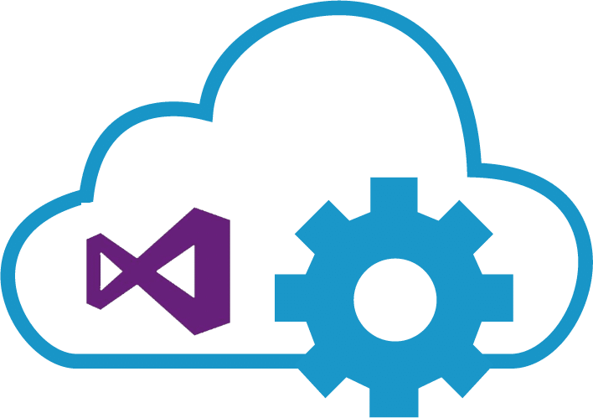
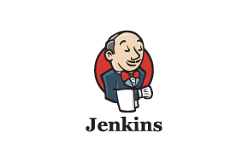
Test Orchestrator
Git Test
Notes:
Part 1: Test Orchestrator
A test orchestrator is a device which will automatically organize and execute your tests. A test orchestrator does not have to (but can) have a single responsibility. A test orchestrator is absolutely necessary because it is responsible for organizing how, and where your tests are executed. It is also the device which receives feedback from your tests and organizes them in a digestible way.
Examples include TFS, VSTS, Jenkins and even a git plugins such as “git test”.

Slide 26
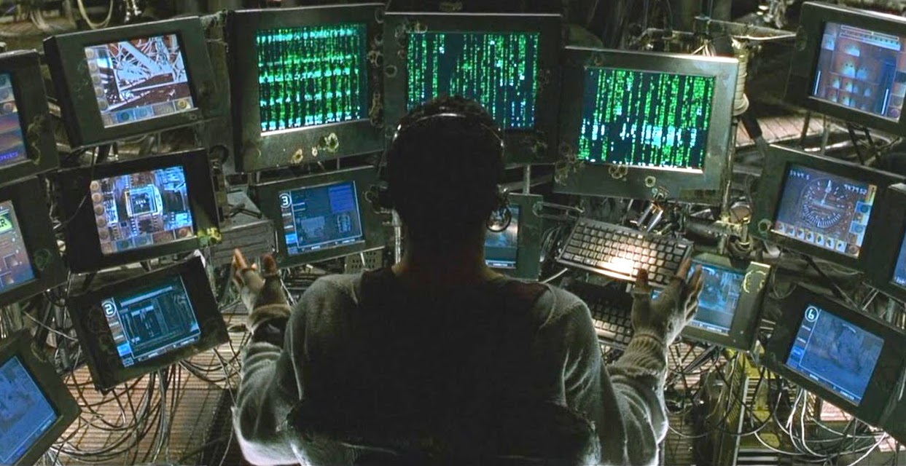
Notes:
The Test Orchestrator is like the Matrix Operator. It sends tests into the environment, and pulls out results when they are done.

Slide 27




Test Execution Environment
Notes:
Part 2: Test Execution Environment
A test execution environment is the set of machines or devices where your tests will run. It is the receiving end of the test automation delivery channel. The test execution environment receives tests from the test orchestrator, runs them and gives feedback to the test orchestrator about the test runs.
Examples of these environments include but are not limited to: XTC, MTM, Sauce, and Selenium Grid.

Slide 28
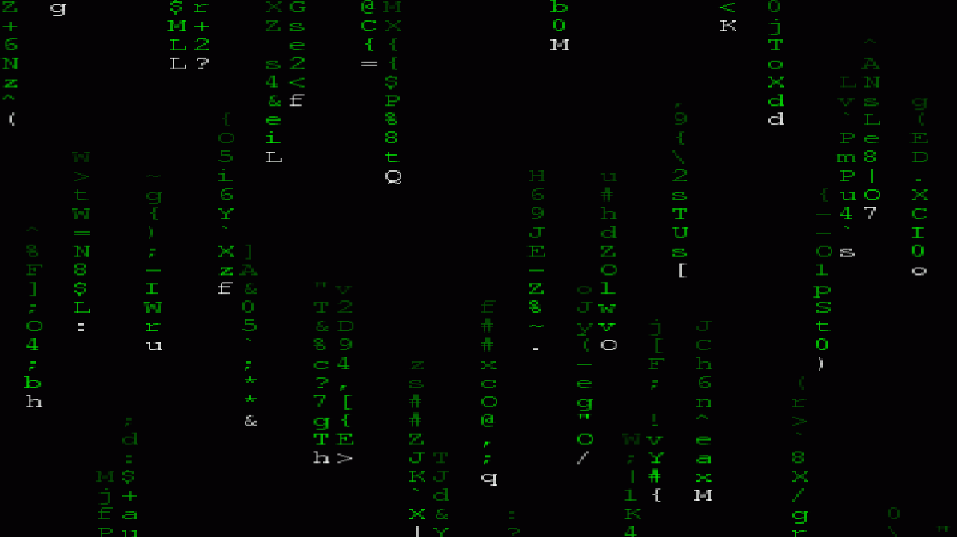
Notes:
If the test orchestrator is the matrix operator, then the execution environment is THE MATRIX MAN….IT RUNS THE TESTS, IT CONTROLS THE TESTS…as far as the tests are concerned, it doesn’t even exist. It’s THEIR WORLD!

Slide 29
Test Automation Pipeline
“Take the red pill, you stay in Wonderland, and I show you how deep the rabbit hole goes.”
-Morpheus, Matrix, 1999

Slide 30
Test Automation Pipeline Process Implementation
Notes:
General Notes:
*Take screenshots instead of videos (LARGE)
*What value is there in logging in???
*NO LASER POINTING!!!!!!
*Take screenshots and put boxes to draw attention
*Full screen lower resolution
*Ignore template for screenshots
*Use the space that you need: IMAGE: Edge to edge
*Ditch videos and replace with screenshots
*Do not do videos inside the template
*Modify template to take up less room
-Paid vs. Free flowchart bogged down
-Customize to show other tools can be plugged in
-incorporate a few more points of view
-Use the logo and move it to bottom left , to free up some real estate
-Don’t use graphics for background , use powerpoint objects
-Bring back the story, lost in the middle, try to tie the threads

Slide 31


Slide 32
Test Automation Pipeline Step 1: Pick A Test Orchestrator
Notes:
General Notes:
*Take screenshots instead of videos (LARGE)
*What value is there in logging in???
*NO LASER POINTING!!!!!!
*Take screenshots and put boxes to draw attention
*Full screen lower resolution
*Ignore template for screenshots
*Use the space that you need: IMAGE: Edge to edge
*Ditch videos and replace with screenshots
*Do not do videos inside the template
*Modify template to take up less room
-Paid vs. Free flowchart bogged down
-Customize to show other tools can be plugged in
-incorporate a few more points of view
-Use the logo and move it to bottom left , to free up some real estate
-Don’t use graphics for background , use powerpoint objects
-Bring back the story, lost in the middle, try to tie the threads

Slide 33
Step 1: Pick A Test Orchestrator
START
Existing Infra?
Configure Existing!!
YES
NO
Budget?
Open Source
Paid Tool
NO
YES
Notes:
Step 1: Pick A Test Orchestrator
In the slides above we established that a test orchestrator is a device which will automatically organize and execute your tests, and provide a way to view feedback. We noted that Microsoft’s Test Manager , TFS, VSTS or Jenkins, or even Git plugins are all acceptable test orchestrator types. Other industry specific orchestrators such as Quality Center are also acceptable choices. When picking our team’s orchestrators, I found myself answering the following questions, which narrowed my choice down:

Slide 34
Step 1: Pick A Test Orchestrator
START
Existing Infra?
Configure Existing!!
YES
NO
Budget?
Open Source
Paid Tool
NO
YES
Notes:
Can I Piggyback On To An Existing Product Which My Team Is Using?
If the answer is yes, I would just stick with this product. I prefer to re-purpose tools, and in the interest of causing as little adoption friction as possible, would suggest you do too. Change is hard, why introduce additional layers of complication?

Slide 35
Step 1: Pick A Test Orchestrator
START
Existing Infra?
Configure Existing!!
YES
NO
Budget?
Open Source
Paid Tool
NO
YES
Notes:
1. Can I Piggyback On To An Existing Environment Which My Team Is Using?
Is there a series of VMs I can use for testing? Is there a Selenium Grid implemented from another team?
REDUCE COMPLEXITY!

Slide 36
Step 1: Pick A Test Orchestrator
START
Existing Infra?
Configure Existing!!
YES
NO
Budget?
Open Source
Paid Tool
NO
YES

Slide 37
Step 1: Pick A Test Orchestrator
START
Existing Infra?
Configure Existing!!
YES
NO
Budget?
Open Source
Paid Tool
NO
YES

Slide 38
Step 1: Pick A Test Orchestrator
START
Existing Infra?
Configure Existing!!
YES
NO
Budget?
Open Source
Paid Tool
NO
YES
Notes:
If there’s no money, we choose open source. This is a great way to get the ball rolling. Sometimes budgets are not able to be acquired until value is shown. Open Source tool implementation is a great way to show value! Open Source implementation can be just as good as paid tool implementation, it just depends on your situation and your team culture!

Slide 39
Step 1: Pick A Test Orchestrator
START
Existing Infra?
Configure Existing!!
YES
NO
Budget?
Open Source
Paid Tool
NO
YES

Slide 40
Step 1: Pick A Test Orchestrator
START
Existing Infra?
Configure Existing!!
YES
NO
Budget?
Open Source
Paid Tool
NO
YES
Notes:
Begging for Money is a great way of getting to the paid tool you desire, but so is a trial, that builds up your POC. This is an excellent way of seeing if a tool works for you. If it does, you have an idea of what you are getting into, if it doesn’t, you haven’t wasted a lot of effort.

Slide 41
Test Automation Pipeline Example Orchestrator
Notes:
General Notes:
*Take screenshots instead of videos (LARGE)
*What value is there in logging in???
*NO LASER POINTING!!!!!!
*Take screenshots and put boxes to draw attention
*Full screen lower resolution
*Ignore template for screenshots
*Use the space that you need: IMAGE: Edge to edge
*Ditch videos and replace with screenshots
*Do not do videos inside the template
*Modify template to take up less room
-Paid vs. Free flowchart bogged down
-Customize to show other tools can be plugged in
-incorporate a few more points of view
-Use the logo and move it to bottom left , to free up some real estate
-Don’t use graphics for background , use powerpoint objects
-Bring back the story, lost in the middle, try to tie the threads

Slide 42
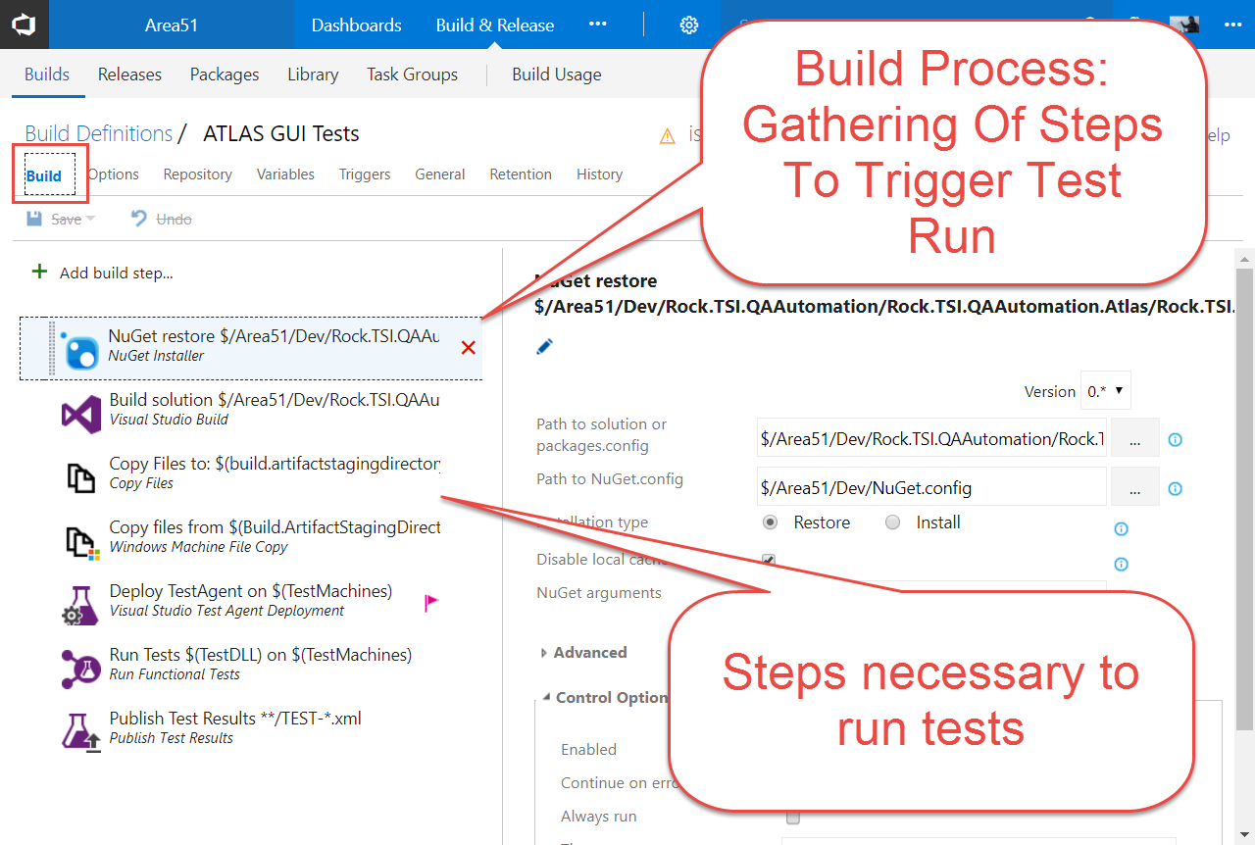

Slide 43
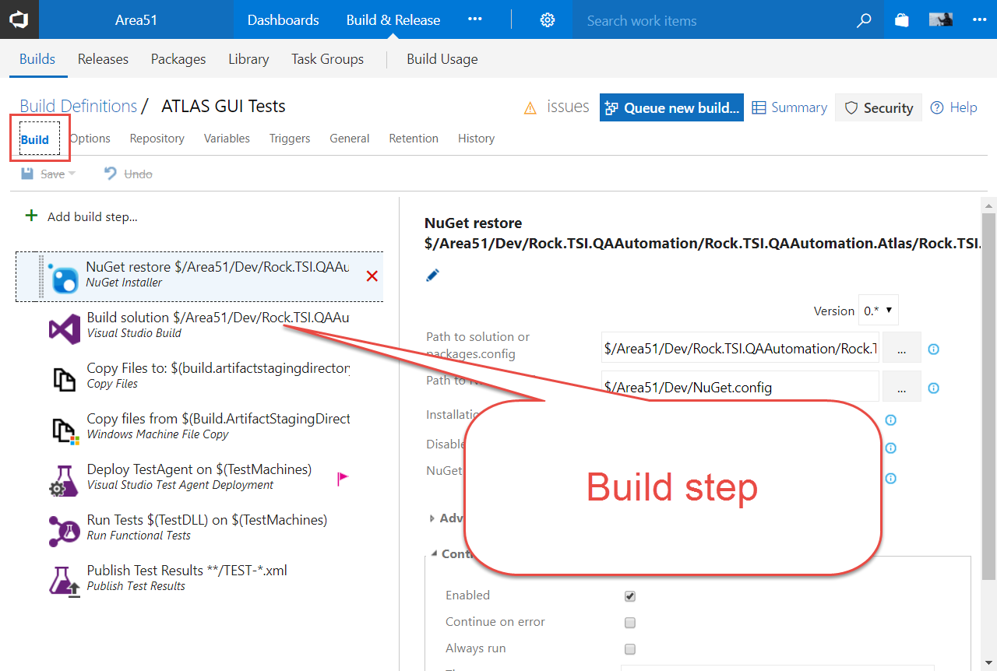

Slide 44
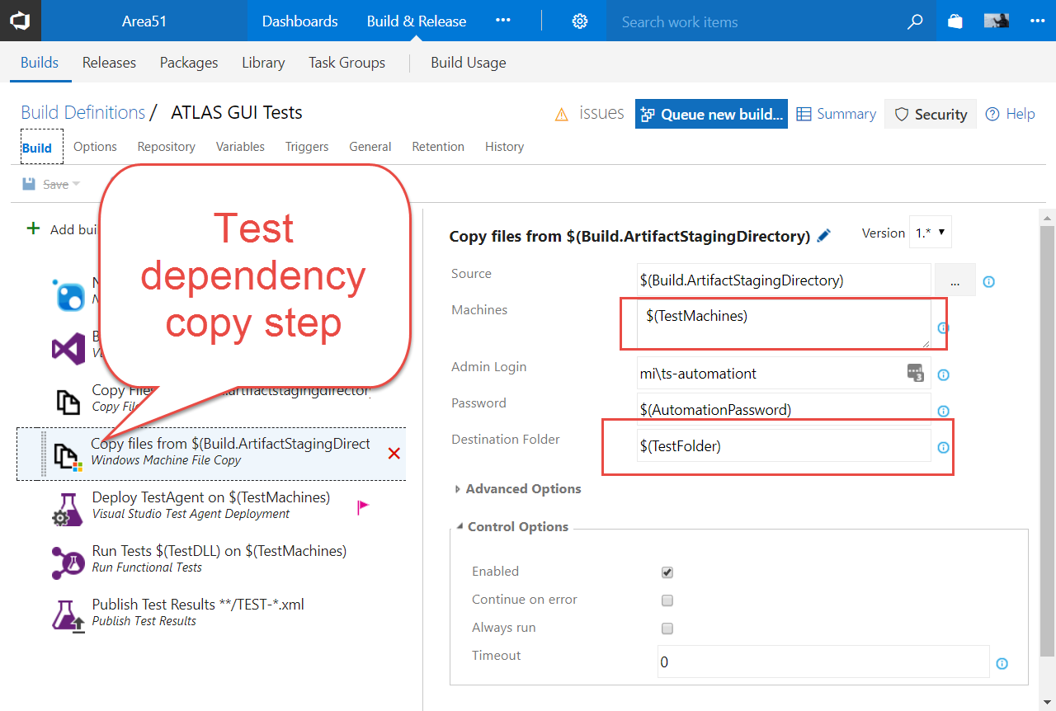

Slide 45
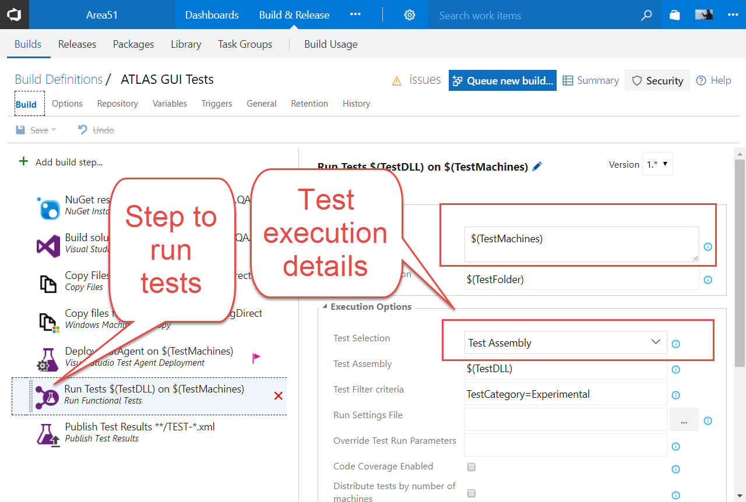

Slide 46
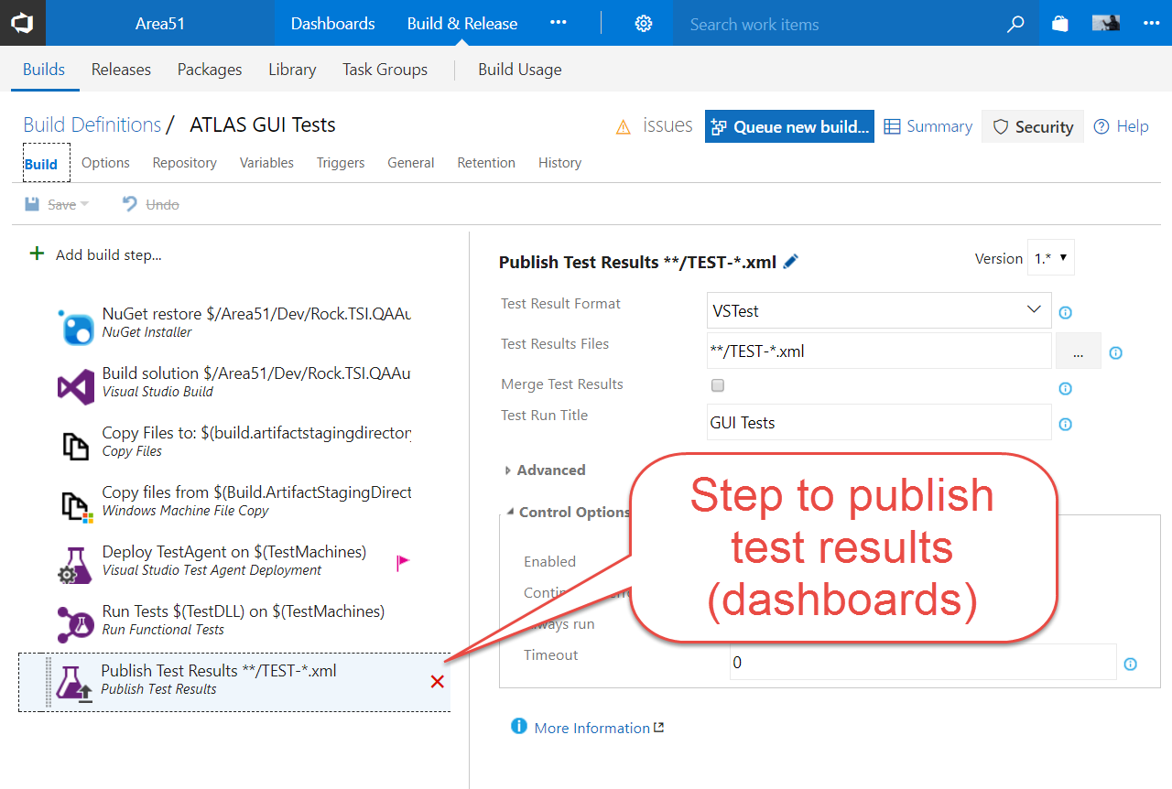

Slide 47
Test Automation Pipeline Step 2: Pick A Test Execution Environment
Notes:
General Notes:
*Take screenshots instead of videos (LARGE)
*What value is there in logging in???
*NO LASER POINTING!!!!!!
*Take screenshots and put boxes to draw attention
*Full screen lower resolution
*Ignore template for screenshots
*Use the space that you need: IMAGE: Edge to edge
*Ditch videos and replace with screenshots
*Do not do videos inside the template
*Modify template to take up less room
-Paid vs. Free flowchart bogged down
-Customize to show other tools can be plugged in
-incorporate a few more points of view
-Use the logo and move it to bottom left , to free up some real estate
-Don’t use graphics for background , use powerpoint objects
-Bring back the story, lost in the middle, try to tie the threads

Slide 48
Step 2: Pick A Test Execution Environment
START
Existing Infra?
Configure Existing!!
YES
NO
Budget?
Open Source
Paid Tool
NO
YES
NO
Beg for $
Notes:
Step 1: Pick A Test Orchestrator
In the slides above we established that a test orchestrator is a device which will automatically organize and execute your tests, and provide a way to view feedback. We noted that Microsoft’s Test Manager , TFS, VSTS or Jenkins, or even Git plugins are all acceptable test orchestrator types. Other industry specific orchestrators such as Quality Center are also acceptable choices. When picking our team’s orchestrators, I found myself answering the following questions, which narrowed my choice down:

Slide 49
Step 2: Pick A Test Execution Environment
START
Existing Infra?
Configure Existing!!
YES
NO
Budget?
Open Source
Paid Tool
NO
YES
NO
Beg for $
Notes:
Can I Piggyback On To An Existing Environment Which My Team Is Using?
Is there a series of VMs I can use for testing? Is there a Selenium Grid implemented from another team?

Slide 50
Step 2: Pick A Test Execution Environment
START
Existing Infra?
Configure Existing!!
YES
NO
Budget?
Open Source
Paid Tool
NO
YES
NO
Beg for $
Notes:
1. Can I Piggyback On To An Existing Environment Which My Team Is Using?
Is there a series of VMs I can use for testing? Is there a Selenium Grid implemented from another team?
REDUCE COMPLEXITY!

Slide 51
Step 2: Pick A Test Execution Environment
START
Existing Infra?
Configure Existing!!
YES
NO
Budget?
Open Source
Paid Tool
NO
YES
NO
Beg for $

Slide 52
Step 2: Pick A Test Execution Environment
START
Existing Infra?
Configure Existing!!
YES
NO
Budget?
Open Source
Paid Tool
NO
YES
NO
Beg for $

Slide 53
Step 2: Pick A Test Execution Environment
START
Existing Infra?
Configure Existing!!
YES
NO
Budget?
Open Source
Paid Tool
NO
YES
NO
Beg for $
Notes:
If there’s no money, we choose open source. This is a great way to get the ball rolling. Sometimes budgets are not able to be acquired until value is shown. Open Source tool implementation is a great way to show value! Open Source implementation can be just as good as paid tool implementation, it just depends on your situation and your team culture!

Slide 54
Step 2: Pick A Test Execution Environment
START
Existing Infra?
Configure Existing!!
YES
NO
Budget?
Open Source
Paid Tool
NO
YES
NO
Beg for $

Slide 55
Step 2: Pick A Test Execution Environment
START
Existing Infra?
Configure Existing!!
YES
NO
Budget?
Open Source
Paid Tool
NO
YES
NO
Beg for $
Notes:
Begging for Money is a great way of getting to the paid tool you desire, but so is a trial, that builds up your POC. This is an excellent way of seeing if a tool works for you. If it does, you have an idea of what you are getting into, if it doesn’t, you haven’t wasted a lot of effort.

Slide 56
Step 2: Pick A Test Execution Environment
START
Existing Infra?
Configure Existing!!
YES
NO
Budget?
Open Source
Paid Tool
NO
YES
NO
Beg for $

Slide 57
Test Automation Pipeline Example Execution Environments
Notes:
General Notes:
*Take screenshots instead of videos (LARGE)
*What value is there in logging in???
*NO LASER POINTING!!!!!!
*Take screenshots and put boxes to draw attention
*Full screen lower resolution
*Ignore template for screenshots
*Use the space that you need: IMAGE: Edge to edge
*Ditch videos and replace with screenshots
*Do not do videos inside the template
*Modify template to take up less room
-Paid vs. Free flowchart bogged down
-Customize to show other tools can be plugged in
-incorporate a few more points of view
-Use the logo and move it to bottom left , to free up some real estate
-Don’t use graphics for background , use powerpoint objects
-Bring back the story, lost in the middle, try to tie the threads

Slide 58
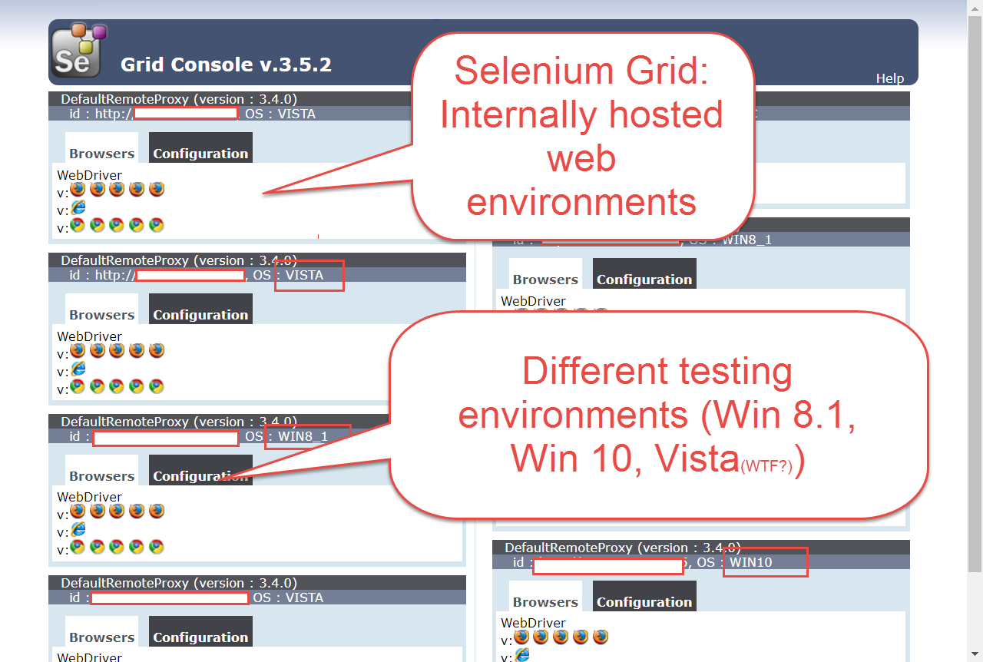
Notes:
Note that this is an example from TFS, but most orchestration tools allow for this!

Slide 59
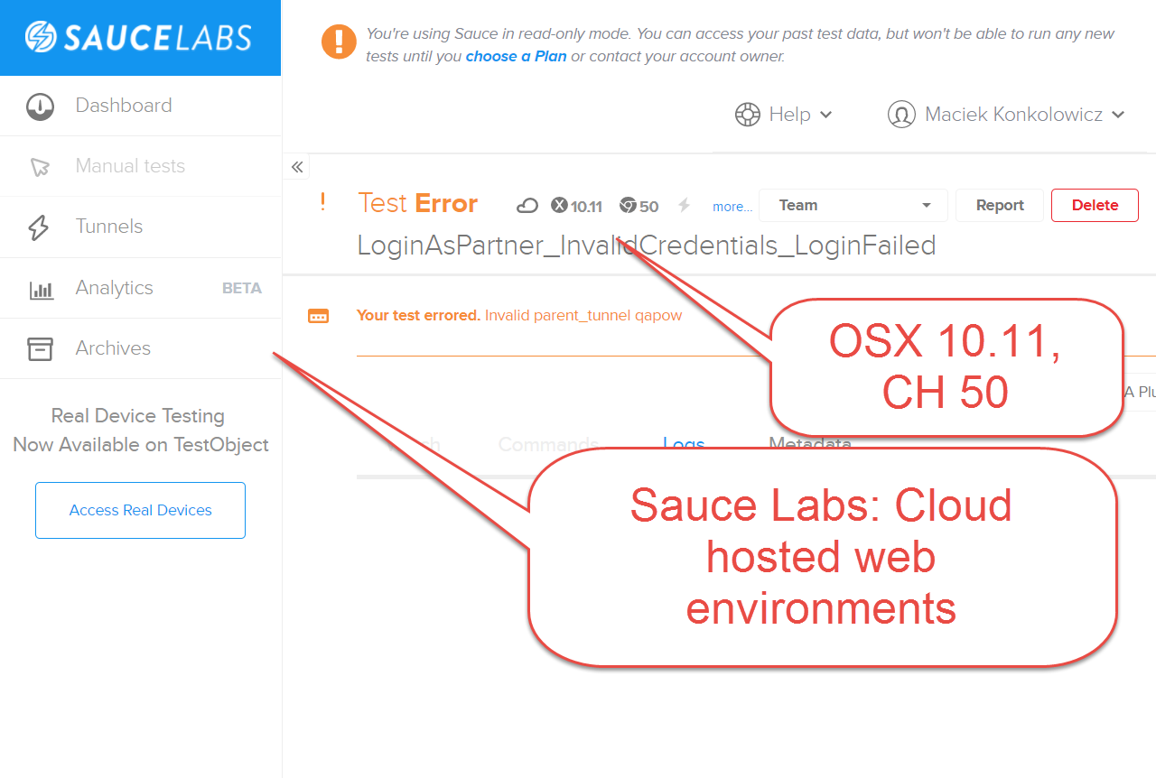
Notes:
Note that this is an example from TFS, but most orchestration tools allow for this!

Slide 60
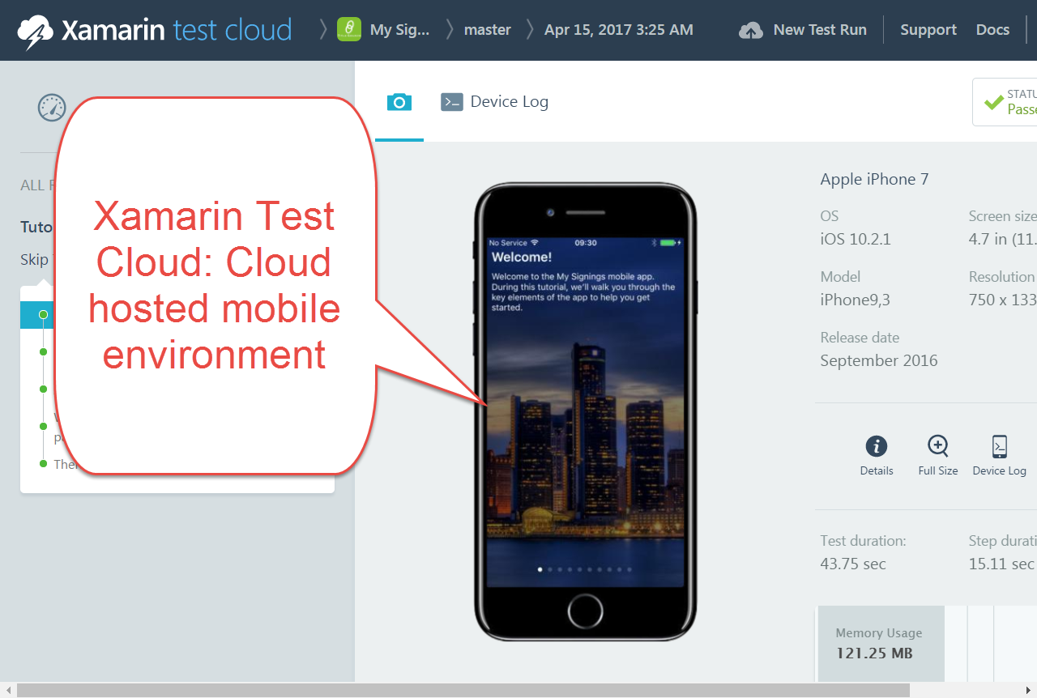
Notes:
Note that this is an example from TFS, but most orchestration tools allow for this!

Slide 61
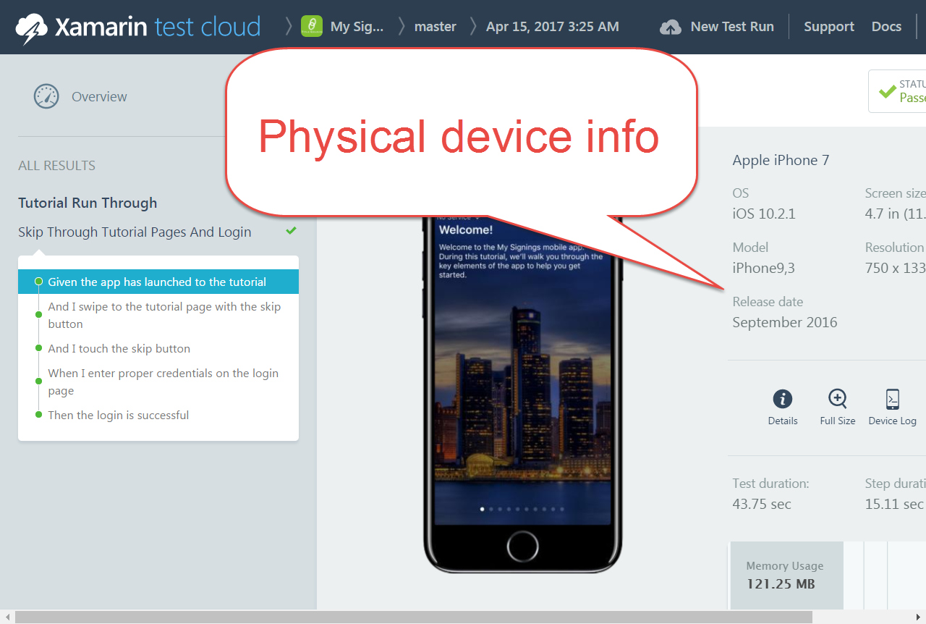
Notes:
Note that this is an example from TFS, but most orchestration tools allow for this!

Slide 62
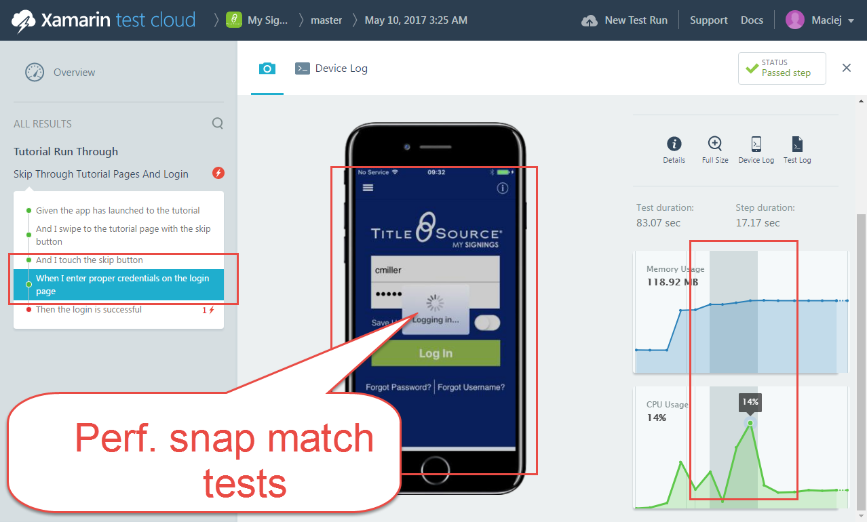
Notes:
Note that this is an example from TFS, but most orchestration tools allow for this!

Slide 63
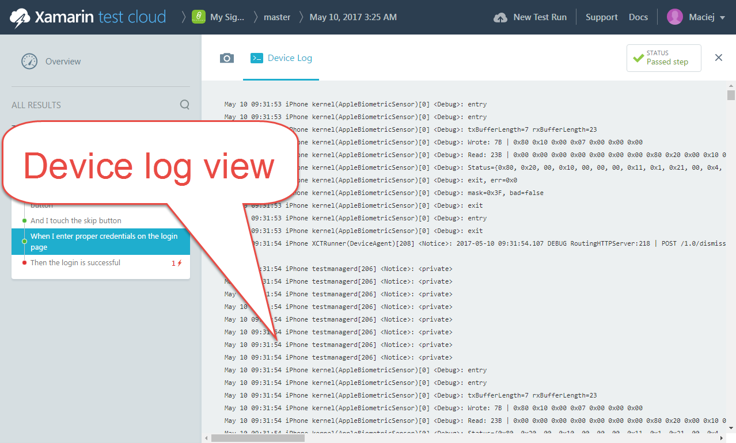
Notes:
Note that this is an example from TFS, but most orchestration tools allow for this!

Slide 64
Test Automation Pipeline Step 3: Define Your Trigger Strategy
Notes:
General Notes:
*Take screenshots instead of videos (LARGE)
*What value is there in logging in???
*NO LASER POINTING!!!!!!
*Take screenshots and put boxes to draw attention
*Full screen lower resolution
*Ignore template for screenshots
*Use the space that you need: IMAGE: Edge to edge
*Ditch videos and replace with screenshots
*Do not do videos inside the template
*Modify template to take up less room
-Paid vs. Free flowchart bogged down
-Customize to show other tools can be plugged in
-incorporate a few more points of view
-Use the logo and move it to bottom left , to free up some real estate
-Don’t use graphics for background , use powerpoint objects
-Bring back the story, lost in the middle, try to tie the threads

Slide 65
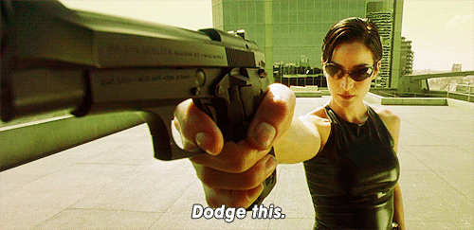
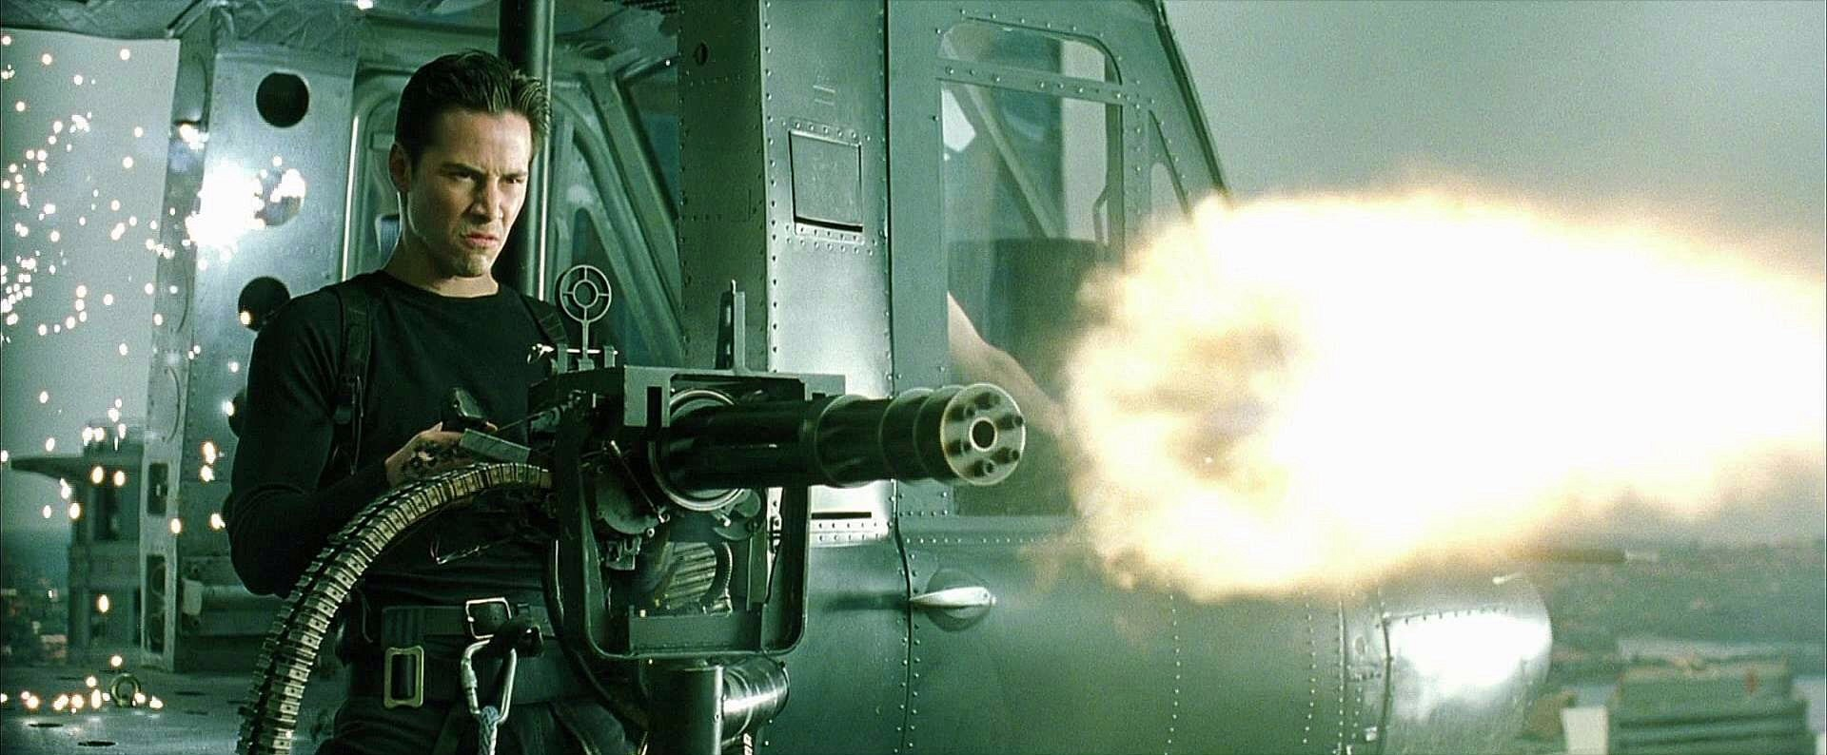
Step 3: Define Your Trigger Strategy
Notes:
Once you have decided your test orchestrator, execution environment and confirmed at least one device or machine in the execution environment can communicate with the test controller, it's time to define how often your tests will run. This decision is again specific to what your team needs, the execution time of your tests, and the cost for execution. Your trigger strategy should depend on how quickly your team needs to receive feedback from your test suite. Ideally, your test suite execution should align with your deployment strategy. The more frequently you deploy your product, the more frequently you should run your test suites to validate functionality.
Do you need trinity and her pistol? Or Neo and his mini gun?

Slide 66
Test Automation Pipeline Example Trigger Strategy
Notes:
General Notes:
*Take screenshots instead of videos (LARGE)
*What value is there in logging in???
*NO LASER POINTING!!!!!!
*Take screenshots and put boxes to draw attention
*Full screen lower resolution
*Ignore template for screenshots
*Use the space that you need: IMAGE: Edge to edge
*Ditch videos and replace with screenshots
*Do not do videos inside the template
*Modify template to take up less room
-Paid vs. Free flowchart bogged down
-Customize to show other tools can be plugged in
-incorporate a few more points of view
-Use the logo and move it to bottom left , to free up some real estate
-Don’t use graphics for background , use powerpoint objects
-Bring back the story, lost in the middle, try to tie the threads

Slide 67
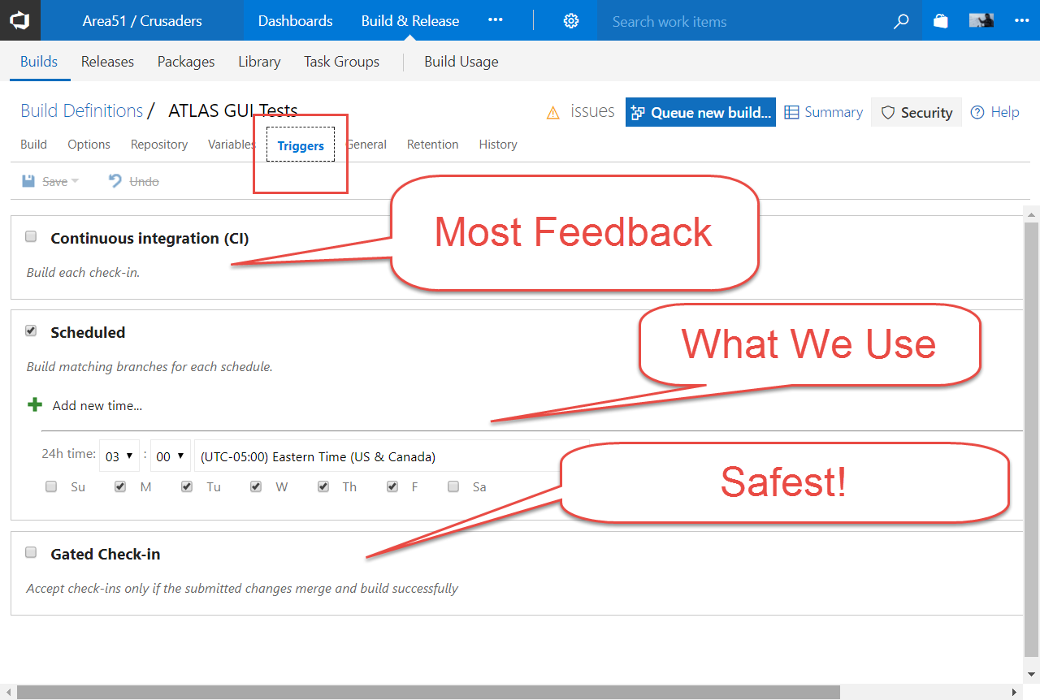
Notes:
Note that this is an example from TFS, but most orchestration tools allow for this!

Slide 68
Test Automation Pipeline Step 4: Educate Your Team
Notes:
General Notes:
*Take screenshots instead of videos (LARGE)
*What value is there in logging in???
*NO LASER POINTING!!!!!!
*Take screenshots and put boxes to draw attention
*Full screen lower resolution
*Ignore template for screenshots
*Use the space that you need: IMAGE: Edge to edge
*Ditch videos and replace with screenshots
*Do not do videos inside the template
*Modify template to take up less room
-Paid vs. Free flowchart bogged down
-Customize to show other tools can be plugged in
-incorporate a few more points of view
-Use the logo and move it to bottom left , to free up some real estate
-Don’t use graphics for background , use powerpoint objects
-Bring back the story, lost in the middle, try to tie the threads

Slide 69

Step 4: Educate Your Team
Notes:
This step is probably the hardest. You have to educate your team about where to find test results and how to push tests through the pipeline! It won’t be as easy as plugging them into the Matrix to learn kung fu, but no fear, you can do it! Let’s see how!

Slide 70
Test Automation Pipeline Example Education Strategies
Notes:
General Notes:
*Take screenshots instead of videos (LARGE)
*What value is there in logging in???
*NO LASER POINTING!!!!!!
*Take screenshots and put boxes to draw attention
*Full screen lower resolution
*Ignore template for screenshots
*Use the space that you need: IMAGE: Edge to edge
*Ditch videos and replace with screenshots
*Do not do videos inside the template
*Modify template to take up less room
-Paid vs. Free flowchart bogged down
-Customize to show other tools can be plugged in
-incorporate a few more points of view
-Use the logo and move it to bottom left , to free up some real estate
-Don’t use graphics for background , use powerpoint objects
-Bring back the story, lost in the middle, try to tie the threads

Slide 71


Slide 72
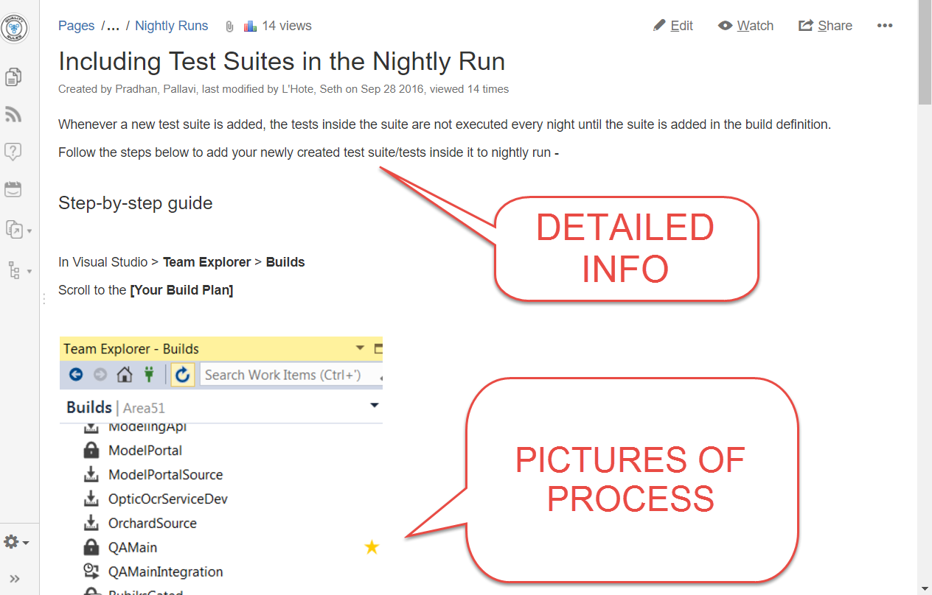

Slide 73


Slide 74
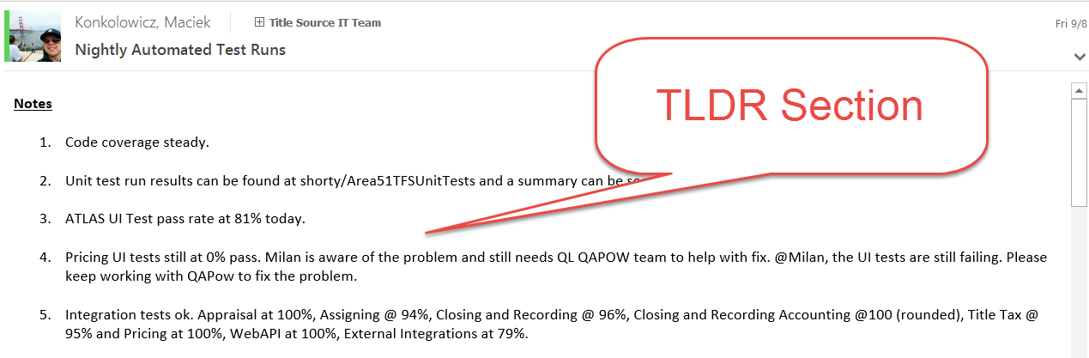

Slide 75
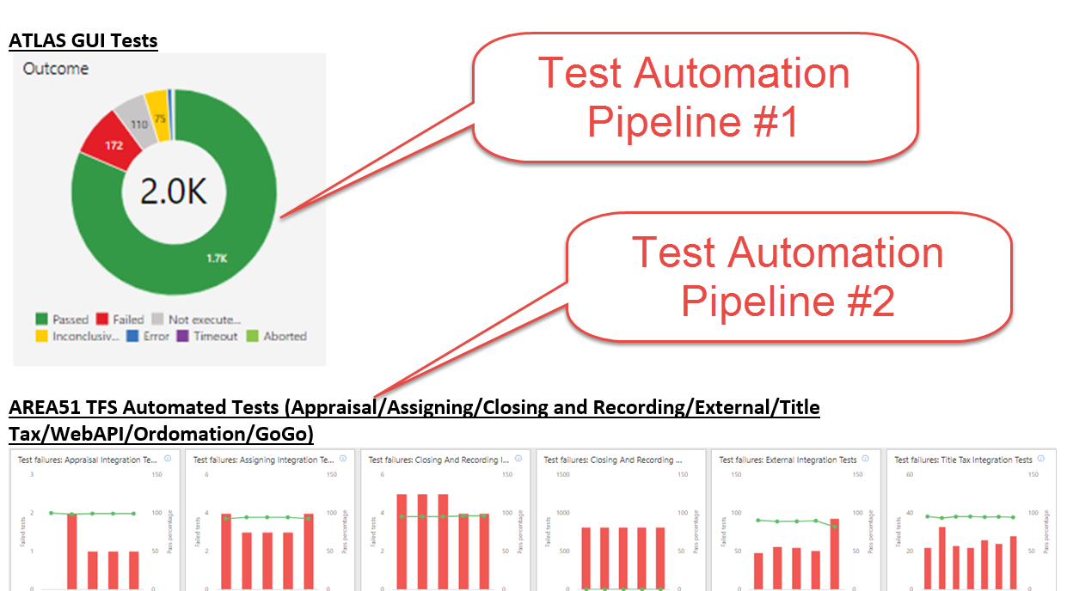

Slide 76


Slide 77
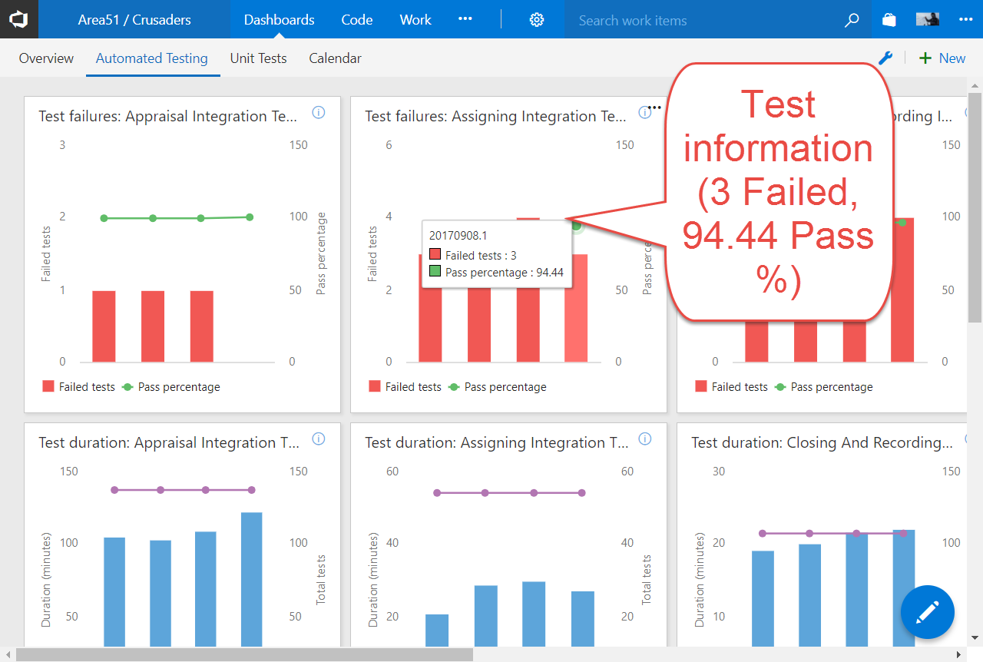

Slide 78
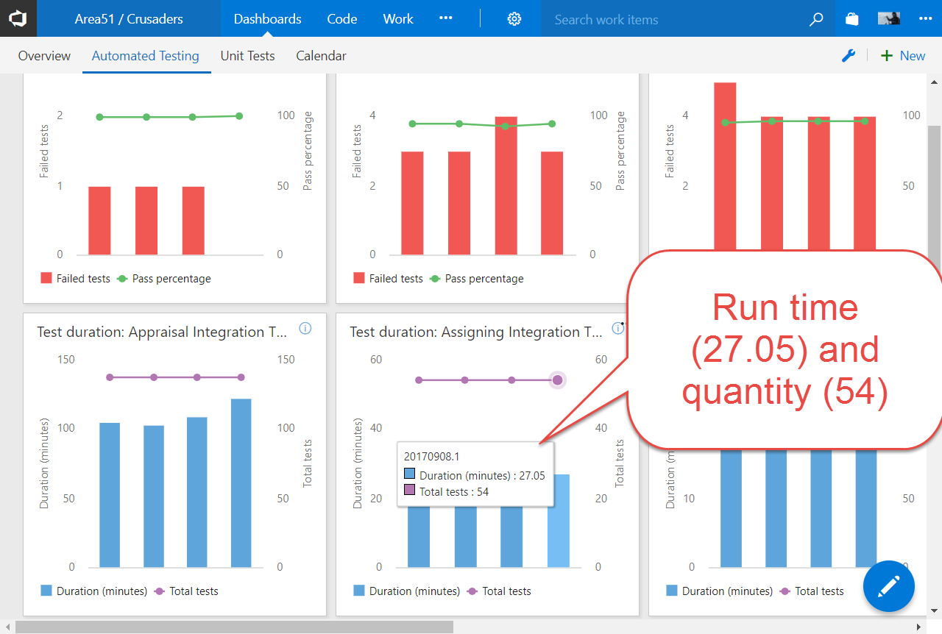

Slide 79

Notes:
Establishing a QA community to bounce ideas off of each other has been huge for us. We have found a place where we can have a safe area for conflict, and then bring a united front to our teams with respect to automation process.

Slide 80
Test Automation Pipeline
“A scalable process for delivery of automated checking that humans shouldn’t need to do!”
-Maciek, Earlier On
Notes:
Let’s step back a bit. We’ve covered a lot of stuff right? We went through the process of the implementation! Let’s ensure we remember what it is we were trying to do and why.

Slide 81
Test Automation Pipeline
GOAL: Scale, Share, Broaden, Your Test Automation!
-Maciek, A little later than earlier on
Notes:
This is what we were trying to achieve! I took you through all the steps, and core concepts, and showed examples. But does this really work? Is the process bullshit?????

Slide 82

Notes:
Nope. Let me show you how it worked for my team. We took the red pill and were able to achieve great results

Slide 83
Test Automation Pipeline Wins
Notes:
General Notes:
*Take screenshots instead of videos (LARGE)
*What value is there in logging in???
*NO LASER POINTING!!!!!!
*Take screenshots and put boxes to draw attention
*Full screen lower resolution
*Ignore template for screenshots
*Use the space that you need: IMAGE: Edge to edge
*Ditch videos and replace with screenshots
*Do not do videos inside the template
*Modify template to take up less room
-Paid vs. Free flowchart bogged down
-Customize to show other tools can be plugged in
-incorporate a few more points of view
-Use the logo and move it to bottom left , to free up some real estate
-Don’t use graphics for background , use powerpoint objects
-Bring back the story, lost in the middle, try to tie the threads

Slide 84
Scaled Our Tests
4000
1000
3.5hr
3hr
500
< 50
2014
2017
Notes:
Speed (Short Feedback Scaled) *Year 1: No automation, pipeline created for Desktop product *Year 2: 500-1000 test cases in automation for Desktop product, pipeline created and scaled, time to run 500 test cases: 3 hours *Year 3: 1000-2000 test cases in automation for desktop product, time to run 1000 test cases: 3 hours, pipeline scaled out to handle *Current: 4000 test cases, multiple pipelines created in automation for desktop product, time to run 4000 test cases: 3.5 hours, pipelines scaled out to handle
Notes:
Throw out the pyramids
Throw out the “tests”
Simplify the colours
Get rid of the arrows, de-complicate the slides

Slide 85
Broadened Quality
45
10
20
35
15
4
2014
2017
Notes:
At the beginning of our automation effort, we had 4 people contributing to automation.
Today we have 35 QAs, and a growing number of non qas. In the last month, 8 devs (Bobby, Star, Ankita, Jakob, David, Seth, Rich, Rob), 2 BAs (Paul, Nemo) have also contributed!!!

Slide 86


Erika Wilson
Director
IT RAD Integrations
Notes:
Enabling Quality For Team Erika is a director on one of our teams. Although we have a shallow organizational structure, she is two levels below the CIO. In late August, she spotted a drop in our nightly runs for one of our teams. She raised the alarm bell right away, to the team lead, to the Quality Engineer who was already investigating the issue. This incident, is a great example of how sharing our test results has benefitted our team and our quality culture. By giving access to our test pipelines, we are able to proliferate quality throughout our team.

Slide 87


Test Automation Pipeline
Scale, Share, Broaden, Your Test Automation!
Notes:
The automation pipeline enabled our teams to turn on the flow of quality throughout our entire software development life cycle. By implementing early in our automation effort, we were able to grow our test suite to over 4k tests, we were able to proliferate quality awareness across our entire team and we were able to implement automation across many different execution environments. Today we talked about why and how our teams should implement Test Automation Pipelines…I am not conducing drug use, but please follow Morpheus’ advice and take the red pill. Go back to your teams, and implement your test automation pipeline as soon as you can. Thanks so much for your time and attention.

Slide 88
Thanks For Your Time

